Slide 1
Options at 16+ Presentation

Slide 3
So …. to begin
https://www.youtube.com/watch?v=FaMTedT6P0I

Slide 4
Your journey ….
Starts with a first step

Slide 5
Reflect …

Slide 6
Next step …CREATE
Just as in the computer game you need to devise an action plan:
What
Where
Who
When
Why
How

Slide 7
Now …EXPLORE
The opportunities available
You need to understand the 3R’s
Academic
Vocational
Apprenticeship

Slide 8
The Academic Route
This post 16 route is suited to students with a preference for learning by writing assignments, reading widely and tackling examinations.
Most students choose three or four subjects to study .
Students continuing their education in a Sixth Form environment usually intend to go on to university so it is wise to check the entry requirements for degree courses before finalising the subject combination.

Slide 9
The Vocational Route
This route is suitable for students who want to combine theory and practical work.
Most courses take between one and two years to complete, this depends on the size and level of the vocational qualification. Many courses are classroom based. Some include work experience.
These are work-related qualifications that employers and professional bodies helped to develop.
Vocational qualifications are available at many different levels. Most people aged 16 to 19 study for qualifications at Entry Level to Level 3 .
Entry requirements depend on where you study and on the subject and level of your qualification.

Slide 10
The Apprenticeship Route
This route is appropriate for learners who prefer a hands-on learning style. It is important to work hard and get the best results you can, especially in the core subjects as these are often asked for by employers and training providers. An Employer-Led Apprenticeship means that you are employed by a company and you will receive a wage, the company will be linked to a training provider who will deliver the NVQ qualification part of the apprenticeship, usually one day a week.
If you do not have an employer placement but you are ready to start an apprenticeship, then you could consider a pre-apprenticeship programme with a training provider, which should provide you with work experience opportunities and help with getting into employment.
You need to be prepared to take aptitude tests or assessments, especially for engineering, motor vehicle and construction apprenticeships. You can ask for sample tests to help you prepare, but you can also do word and number games to help you. You will also need to prepare carefully for any interviews you are offered – so dress smartly, arrive on time and think about the questions you could be asked.
There are an increasing number of apprenticeship vacancies but they are still very competitive, it is therefore advisable to apply for full-time education as well as a back-up.

Slide 11
A new qualification – a ‘T’ Level
This route is suitable for students who want an alternative to ‘A’ levels and would like to combine theory and practical work. The courses will take two years to complete and will have a substantial work placement as a minimum of 45 days is expected.
These are work-related ‘technical’ qualifications that employers and professional bodies have helped to develop.
Each ‘T’ Level has occupation-specific requirements and students will need to pass all of the elements to achieve the nationally recognised qualification showing an overall grade of pass, merit or distinction.

Slide 12
So … to DISCOVER
www.logonmoveon.co.uk

Slide 13
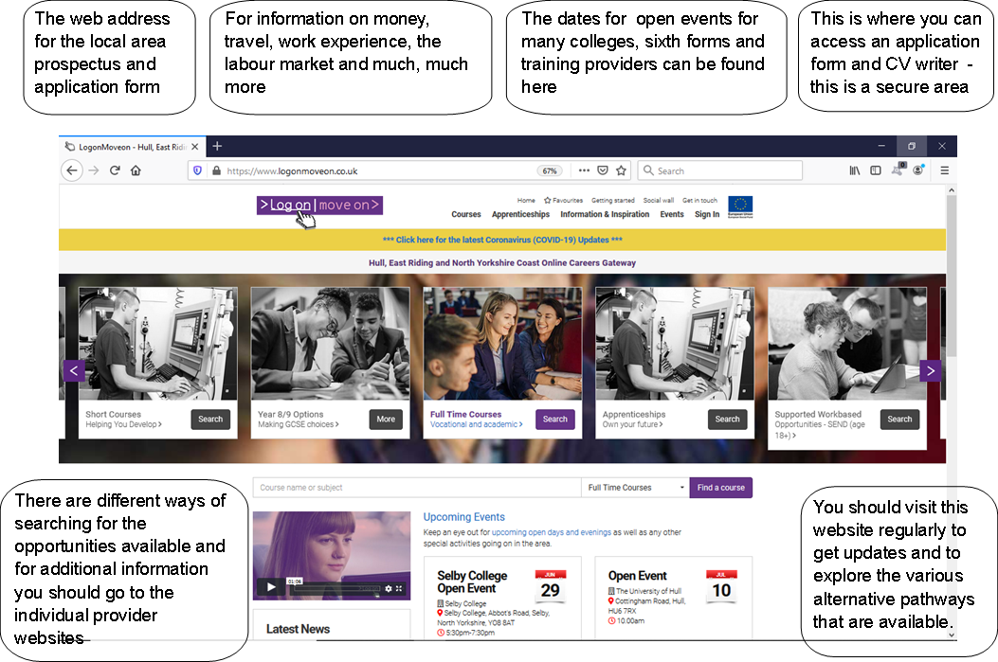

Slide 14
Completing your journey …

Slide 15
Useful websites
www.nationalcareers.service.direct.gov.uk —this site has lots of information including job profiles – the entry requirements, skills and qualities required, pay and conditions. You can also create an account and complete the Skills Assessment and Health Check which help to identify your interests.
www.ucas.com —this is the site for exploring course information, entry qualifications and so on for undergraduate degree courses at university as well as degree apprenticeships.
www.findapprenticeship.service.gov.uk – you can create an account and receive alerts about apprenticeship vacancies that interest you.
Email: sue@purplepatchcareers.co.uk with queries.

