Slide 1
Medicine through Time: Key Figures

Slide 2
Standing on the shoulders of giants…
Throughout History many individuals have shaped the world in which we live.
Many used inspiration or natural genius to make discoveries while others improved on the work of others.
For some in History making discoveries came at huge personal risk; occasionally discoveries were made by accident!
In Medicine there are a number of individuals wh0se work you may need to remember in the exam.

Slide 3
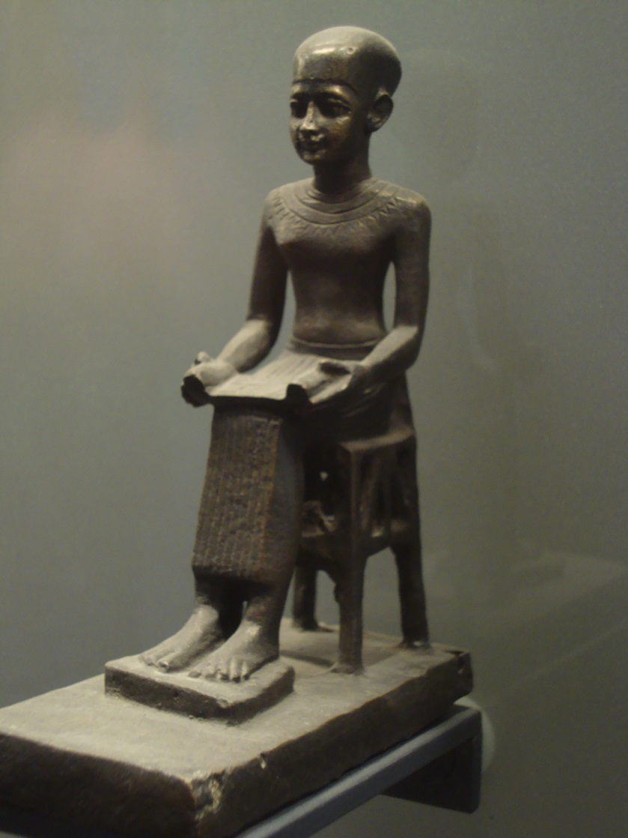
Imhotep(c.2650-2600BC)
Served as Chancellor to the Pharaoh Djoser and was considered the first physician.
Credited with recording several medical techniques recorded on papyrus.
Worshipped as a god after his death.

Slide 4
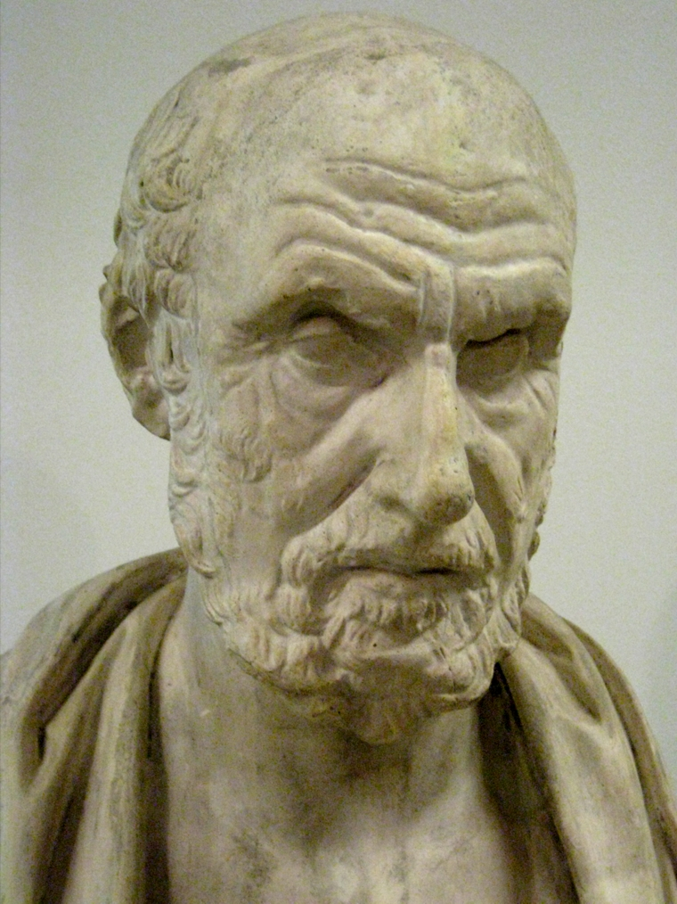
Hippocrates (c.460BC-c.377BC)
Considered the Founding Father of Western medicine.
Believed the balance of elements linked to illness. Also used observation in diagnosis.
Credited with the Hippocratic Corpus & Hippocratic Oath.

Slide 5
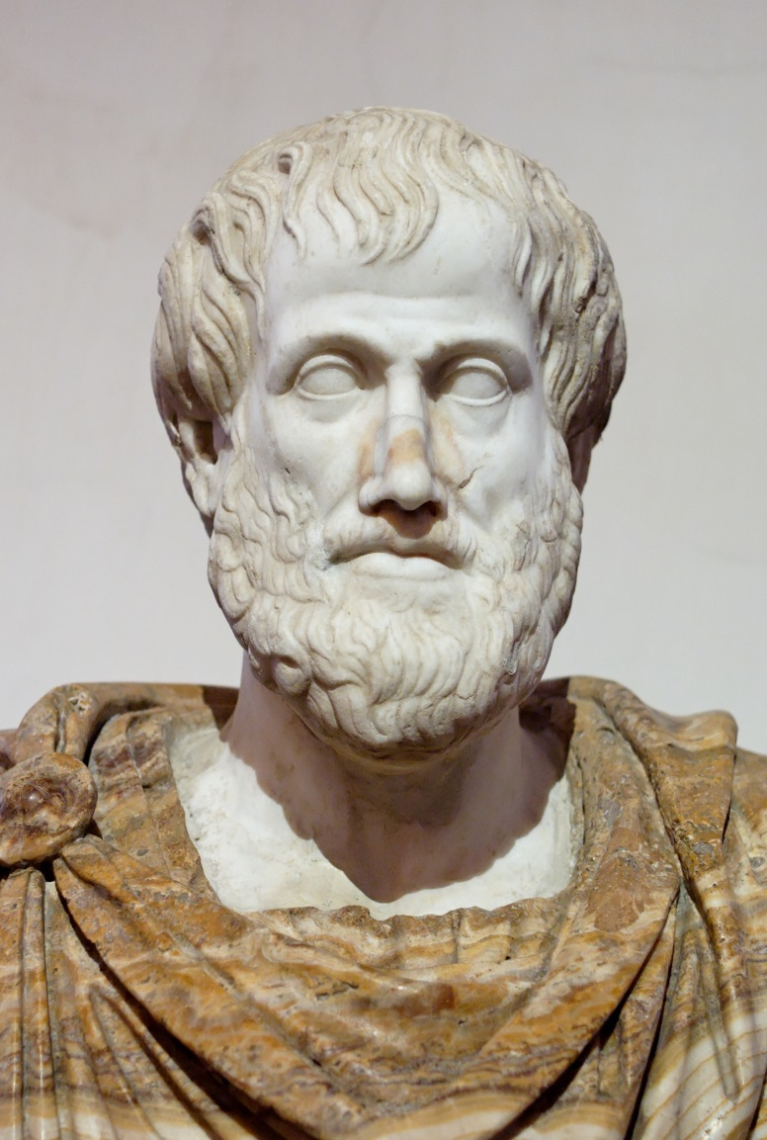
Aristotle (384-322BC)
A Greek philosopher seen as the first genuine scientist.
He developed the Hippocratic idea of balance into the Four Humours; blood, phlegm, yellow bile, black bile.
This influenced treatments seeking to find balance.

Slide 6
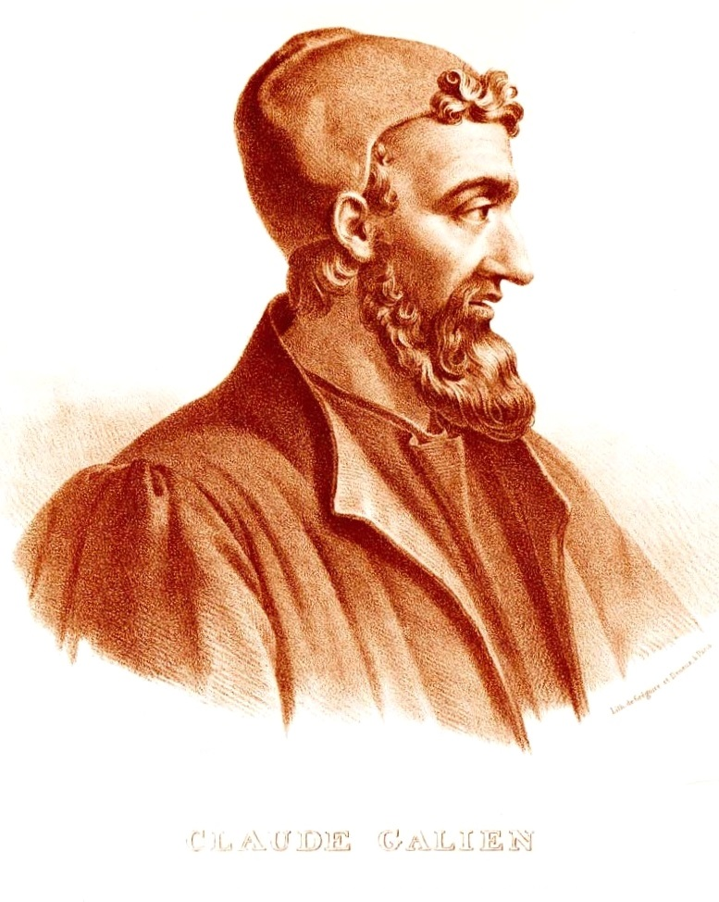
Galen (130AD-200AD)
A Greek citizen of the Roman Empire he trained as a physician in a Gladiator School.
Became the doctor to the Emperor and developed his knowledge with dissection (mainly monkeys)
Developed Theory of Opposites. Ideas lasted over 1,500 years.

Slide 7
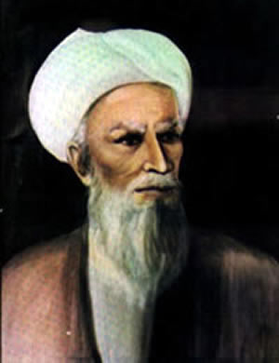
Rhazes (845-925AD)
A Persian polymath, Rhazes made huge contributions to various areas.
He was one of the first to distinguish between contagious diseases like measles & small pox.
His medical works and ideas were used in many Western universities.

Slide 8
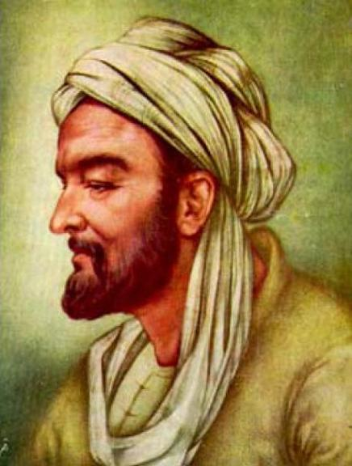
Avicenna (980-1037)
Another Persian, Avicenna is thought to have written over 400 works on various subjects.
His Book of Healing & Canon of Medicine were used in universities until 1650.
He pioneered the use of several drugs and wrote extensively on maintaining health through approach to life.

Slide 9
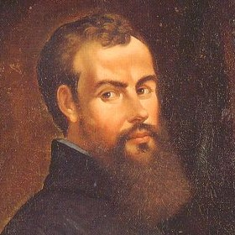
Andreas Vesalius (1514-1564)
A Belgian anatomist, Vesalius worked as a Professor in Padua.
He got talented art students to draw his dissections which he then used to illustrate his book, The Fabric of the Human Body.
Vesalius was one of the first to question Galen’s work.

Slide 10
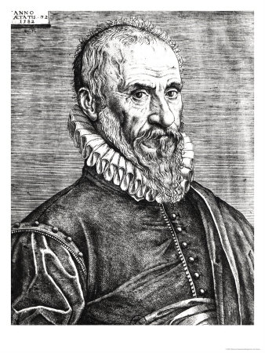
Ambroise Paré (1510-1590)
Trained as a barber (battlefield) surgeon.
He developed new techniques as an alternative to cauterisation and used ligatures successfully.
Recorded his ideas in books which were copied in greater quantities thanks to the Printing Press.

Slide 11
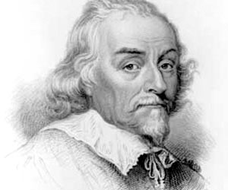
William Harvey (1578-1657)
Trained in Padua before becoming the doctor of James I & Charles I.
Mapped the circulation system of animals explaining how the heart propelled blood around the body.
He was also first to suggest mammals reproduced by the fertilisation of an egg by sperm.

Slide 12
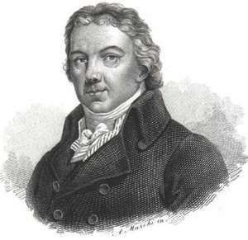
Edward Jenner (1749-1823)
Pioneer of immunology and smallpox vaccination.
At his practice in Gloucestershire developed theory of inoculation.
Noticed that exposure to weak strain of disease could provide immunity.
Idea found resistance but resulted in the prevention of millions of smallpox cases.

Slide 13
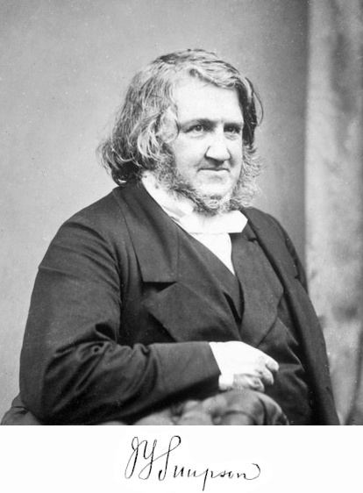
James Simpson (1811-1870)
High profile obstetrician who pioneered the use of anaesthetics.
He experimented with various different chemicals before discovering the effectiveness of chloroform.
Many doctors were initially uncertain but the drug became widely used.

Slide 14
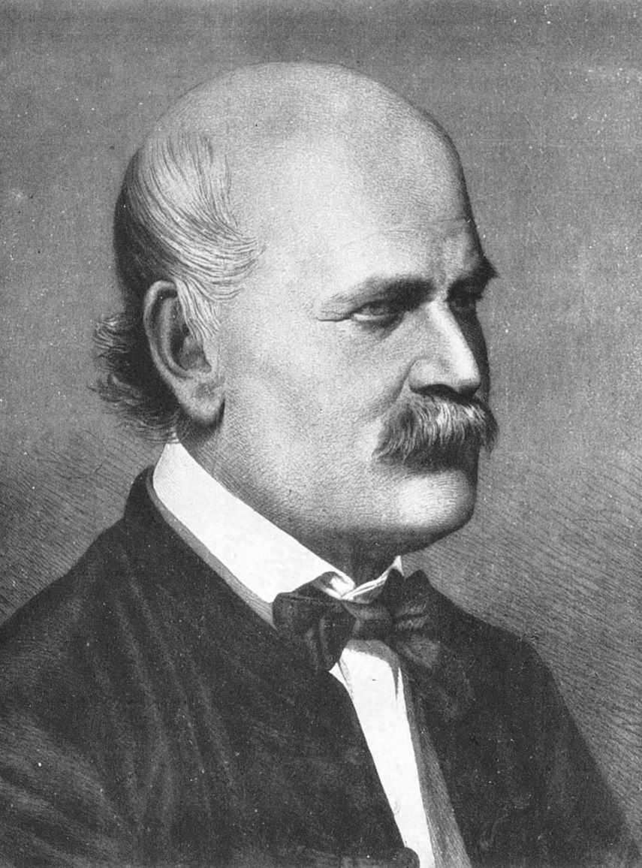
Ignaz Semmelweis (1818-1865)
A Hungarian who worked in Vienna.
Semmelweiss recognised that instances of puerperal fever decreased when doctors washed their hands.
His findings went against accepted medical knowledge.

Slide 15
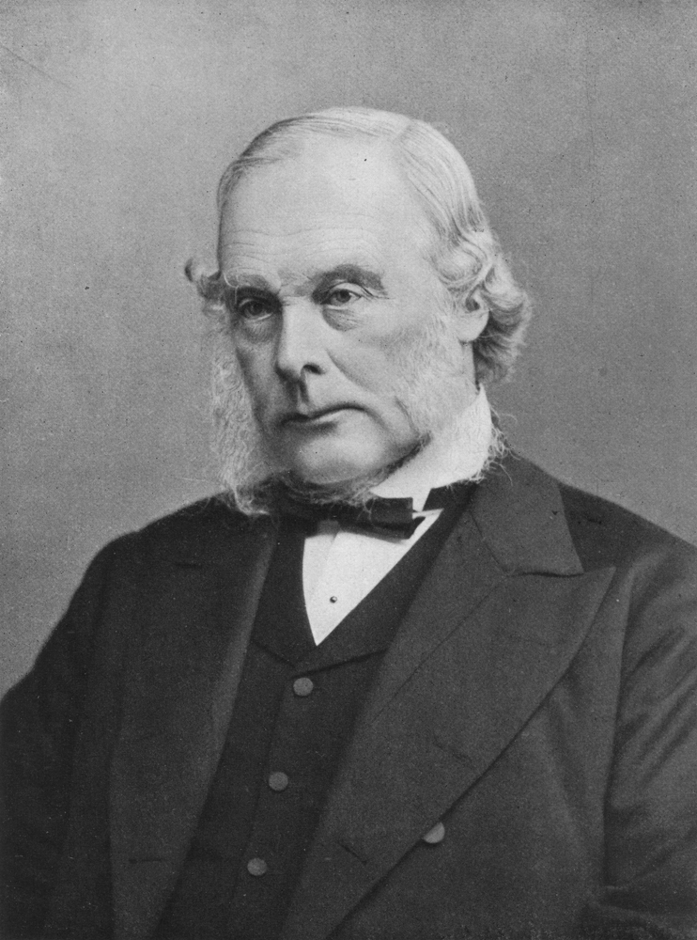
Joseph Lister (1827-1912)
Known as the Father of Antiseptic Surgery.
Inspired by the work of Louis Pasteur he used carbolic acid to clean surgical instruments.
His high success rate and high level of respect led to his techniques being accepted.

Slide 16
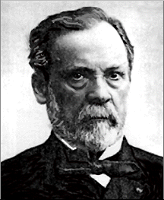
Louis Pasteur (1822-1895)
A French scientist who developed Germ Theory.
During work for French brewers he noticed that micro-organisms grew causing fermentation.
He later used his discoveries to develop vaccines for diseases such as anthrax.

Slide 17
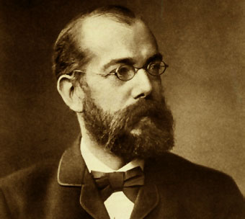
Robert Koch (1843-1910)
A German scientist who developed the theories of Pasteur.
He discovered techniques to stain bacteria so it could be easily identifies.
He isolated the germs that caused anthrax and TB allowing for the development of vaccines.

Slide 18
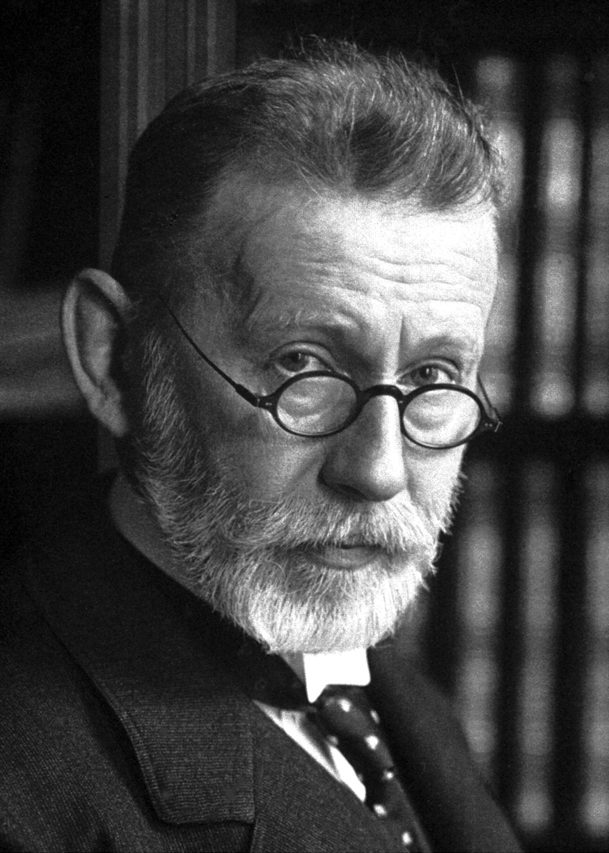
Paul Ehrlich (1854-1915)
A German scientist, Ehrlich worked with Robert Koch.
He developed a ‘magic bullet’ chemical compound (Salvarsan 606) that targeted the syphilis bacteria without damaging the rest of the body.
His work also contributed to the research of chemotherapy.

Slide 19
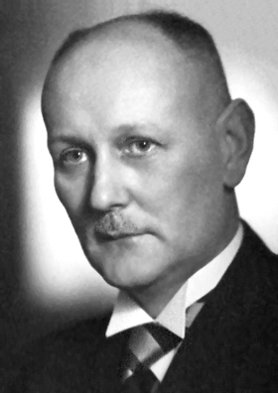
Gerhard Domagk (1895-1964)
A German scientist who investigated the use of dyes as antibiotics.
He discovered a successful treatment of Streptococcus (blood poisoning) which he tested on his daughter.
A key ingredient of the drug he used worked on diseases such as pneumonia.

Slide 20
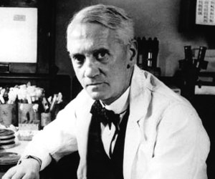
Alexander Fleming (1881-1955)
Became interested in discovering a cure for septic wounds during WWI.
He discovered penicillin by chance after leaving a culture dish exposed to air. A fungal spore landed on the dish and killed the bacteria.
Fleming named the substance but could synthesise enough to ensure its widespread use.

Slide 21
Notable mentions
Herophilus
Lady Montague
John Snow
Edwin Chadwick
Florence Nightingale
Mary Seacole
Elizabeth Garret
Howard Florey & Ernst Chain
Francis Crick & James Watson

